Slide 1
2
DERIVATIVES

Slide 2
2.6
Implicit Differentiation

Slide 3
Implicit Differentiation
The functions that we have met so far can be described by expressing one variable explicitly in terms of another variable.
For example, , or y = x sin x, or in general y = f(x).

Slide 4




Implicit Differentiation
Some functions, are defined implicitly by a relation between x and y such as
or
In some cases it is possible to solve such an equation for y as an explicit function (or several functions) of x.

Slide 5



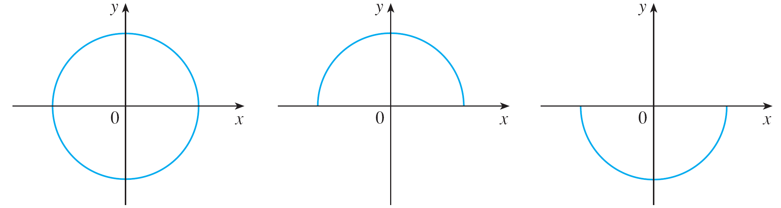


Implicit Differentiation
For instance, if we solve Equation 1 for y, we obtain so two of the functions determined by the implicit Equation 1 are and
The graphs of f and g are the upper and lower semicircles of the circle x ² + y ² = 25. (See Figure 1.)
(a) x² + y² = 25
(b) f(x) =
(c) g(x) =
Figure 1

Slide 6

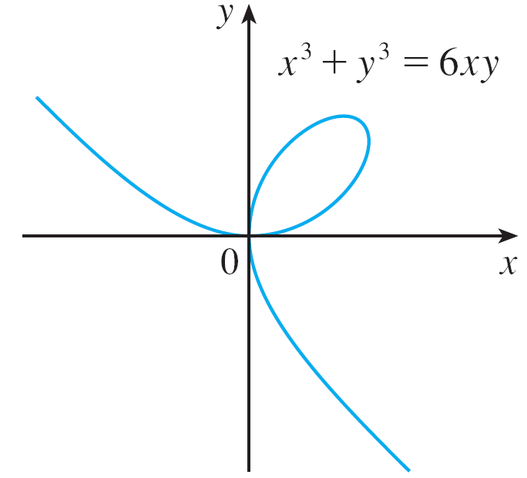
Implicit Differentiation
It’s not easy to solve Equation 2 for y explicitly as a function of x by hand.
Nonetheless, is the equation of a curve called the folium of Descartes shown in Figure 2 and it implicitly defines y as several functions of x.
The folium of Descartes
Figure 2

Slide 7
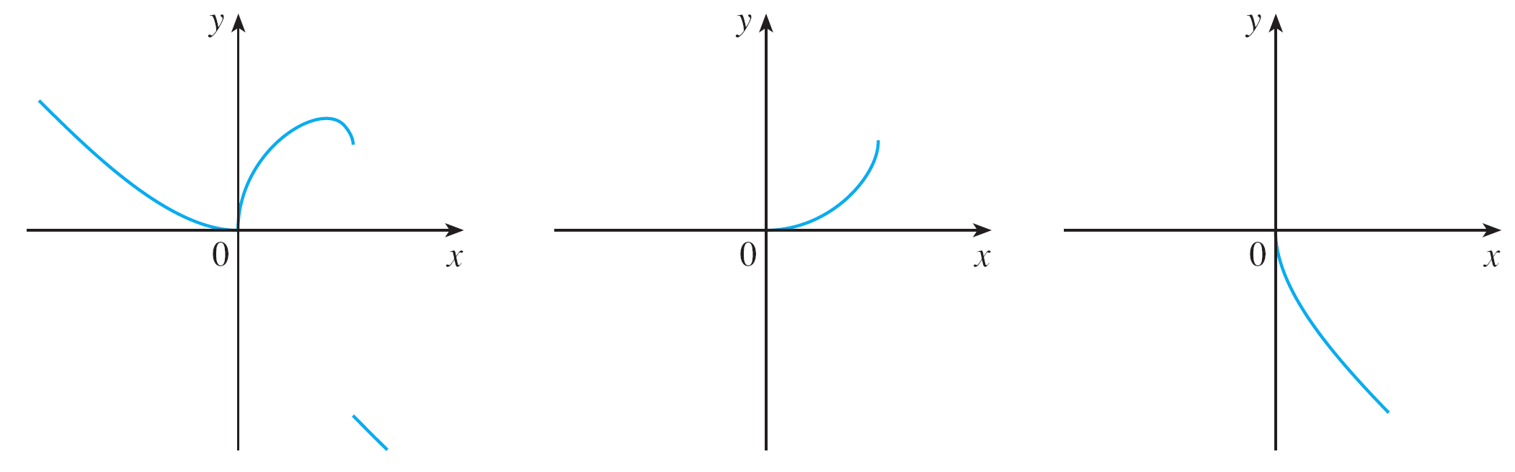
Implicit Differentiation
The graphs of three such functions are shown in Figure 3.
Graphs of three functions defined by the folium of Descartes
Figure 3

Slide 8

Implicit Differentiation
When we say that f is a function defined implicitly by Equation 2, we mean that the equation
is true for all values of x in the domain of f.
To find the derivative of y, it is not necessary to solve an equation for y in terms of x and instead we can use the method of implicit differentiation: This consists of differentiating both sides of the equation with respect to x and then solving the resulting equation for y ′.

Slide 9
Implicit Differentiation
In the examples of this section it is always assumed that the given equation determines y implicitly as a differentiable function of x so that the method of implicit differentiation can be applied.

Slide 10
Example 1
(a)If x² + y² = 25, find .
(b)Find an equation of the tangent to the circle x² + y² = 25 at the point (3, 4).

Slide 11
Example 1(a) SOLUTION 1
Differentiate both sides of the equation x² + y² = 25:

Slide 12
Example 1(a) SOLUTION 1
Remembering that y is a function of x and using the Chain Rule, we have:
Then, we solve this equation for :

Slide 13
Example 1(b) SOLUTION 1
At the point (3, 4) we have x = 3 and y = 4.
So,
Thus, an equation of the tangent to the circle at (3, 4) is: y – 4 = – ¾(x – 3) or 3x + 4y = 25.

Slide 14
Example 1(b) SOLUTION 2
Solving the equation x² + y² = 25, we get:
The point (3, 4) lies on the upper semicircle
So, we consider the function

Slide 15
Example 1(b) SOLUTION 2
Differentiating f using the Chain Rule, we have:

Slide 16
Example 1(b) SOLUTION 2
So,
As in Solution 1, an equation of the tangent is 3x + 4y = 25.

Slide 17


Example 2
(a) Find y ′ if
(b) Find the tangent to the folium of Descartes at the point (3,3).
(c) At what point in the first quadrant is the tangent line horizontal?
SOLUTION:
(a) Differentiating both sides of with respect to x, regarding y as a function of x, and using the Chain Rule on the y ³ term and the Product Rule on the 6xy term, we get

Slide 18



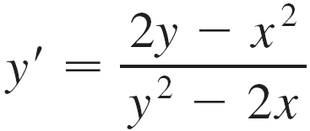
Example 2 – Solution
cont’d
Or
We now solve for y ′:

Slide 19
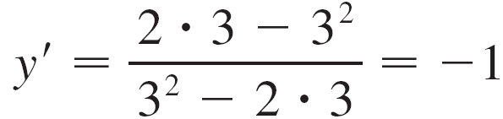
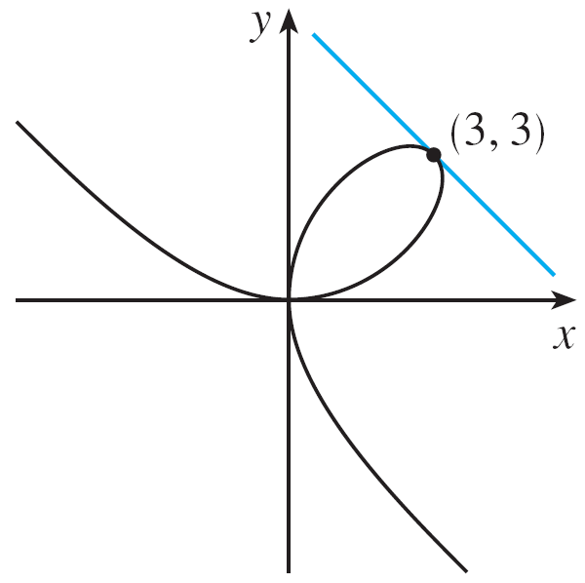
Example 2 – Solution
cont’d
(b) When x = y = 3,
and a glance at Figure 4 confirms that this is a reasonable value for the slope at (3,3).
Figure 4

Slide 20




Example 2 – Solution
cont’d
So an equation of the tangent to the folium at (3, 3) is
or
(c) The tangent line is horizontal if y ′ = 0. Using the expression for y ′ from part (a), we see that y ′ = 0 when 2y – x ² = 0 (provided that y ² – 2x ≠ 0).
Substituting in the equation of the curve, we get
which simplifies to x⁶ = 16x³.

Slide 21



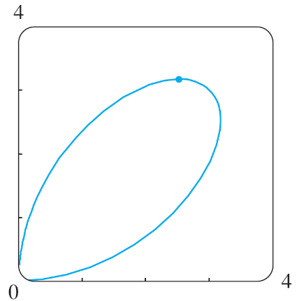
Example 2 – Solution
cont’d
Since x ≠ 0 in the first quadrant, we have x³ = 16.
If , then . Thus the tangent is horizontal at , which is approximately (2.5198, 3.1748).
Looking at Figure 5, we see that our answer is reasonable.
Figure 5

Slide 22

Example 3
Find y ′ if
SOLUTION:
Differentiating implicitly with respect to x and remembering that y is a function of x, we get
(Note that we have used the Chain Rule on the left side and the Product Rule and Chain Rule on the right side.)

Slide 23
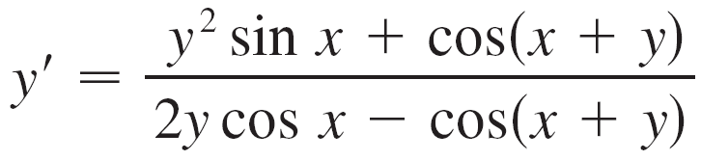
Example 3 – Solution
cont’d
If we collect the terms that involve y ′, we get
So

Slide 24

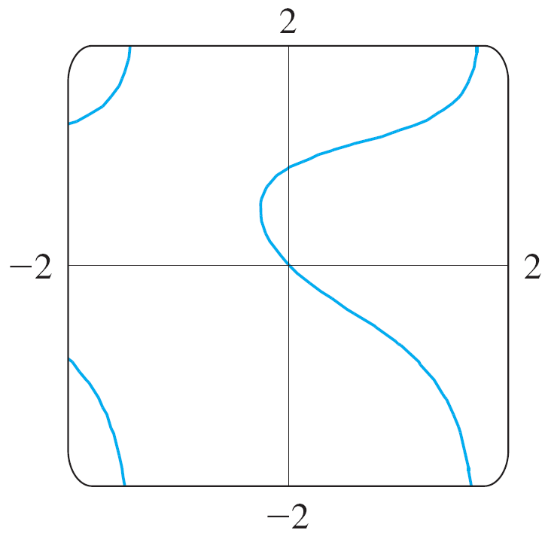
Example 3 – Solution
cont’d
Figure 6, drawn with the implicit-plotting command of a computer algebra system, shows part of the curve
Figure 6

Slide 25
Example 3 – Solution
cont’d
As a check on our calculation, notice that y ′ = –1 when x = y = 0 and it appears from the graph that the slope is approximately –1 at the origin.

Slide 26
Example 4
Find y” if x⁴ + y⁴ = 16.
SOLUTION
Differentiating the equation implicitly with respect to x, we get 4x³ + 4y³y’ = 0.
Solving for y’ gives:

Slide 27
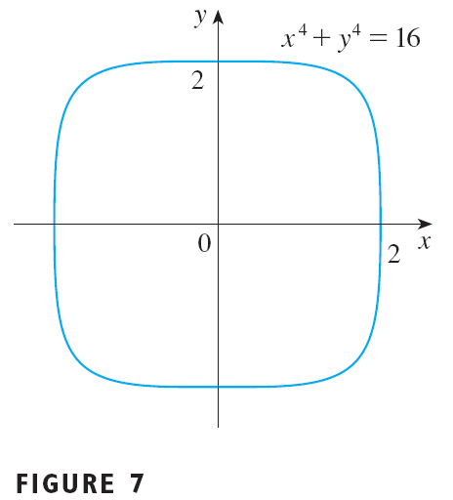
Example 4 SOLUTION
To find y’’, we differentiate this expression for y’ using the Quotient Rule and remembering that y is a function of x:

Slide 28
Example 4 SOLUTION
If we now substitute Equation 3 into this expression, we get:

Slide 29
Example 4 SOLUTION
However, the values of x and y must satisfy the original equation x⁴ + y⁴ = 16.
So, the answer simplifies to:

